Slide 1
Session 10 THE 2^{K} FACTORIAL DESIGN

Slide 2
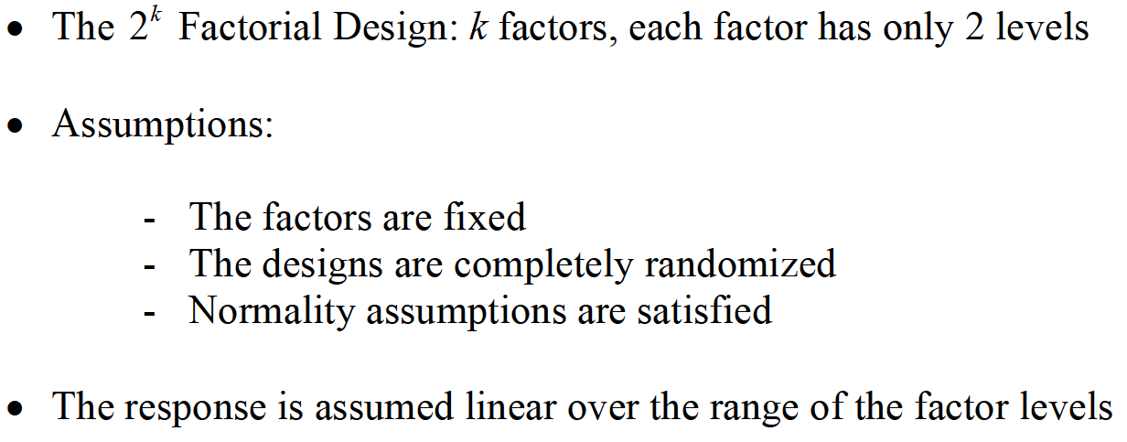
INTRODUCTION

Slide 3
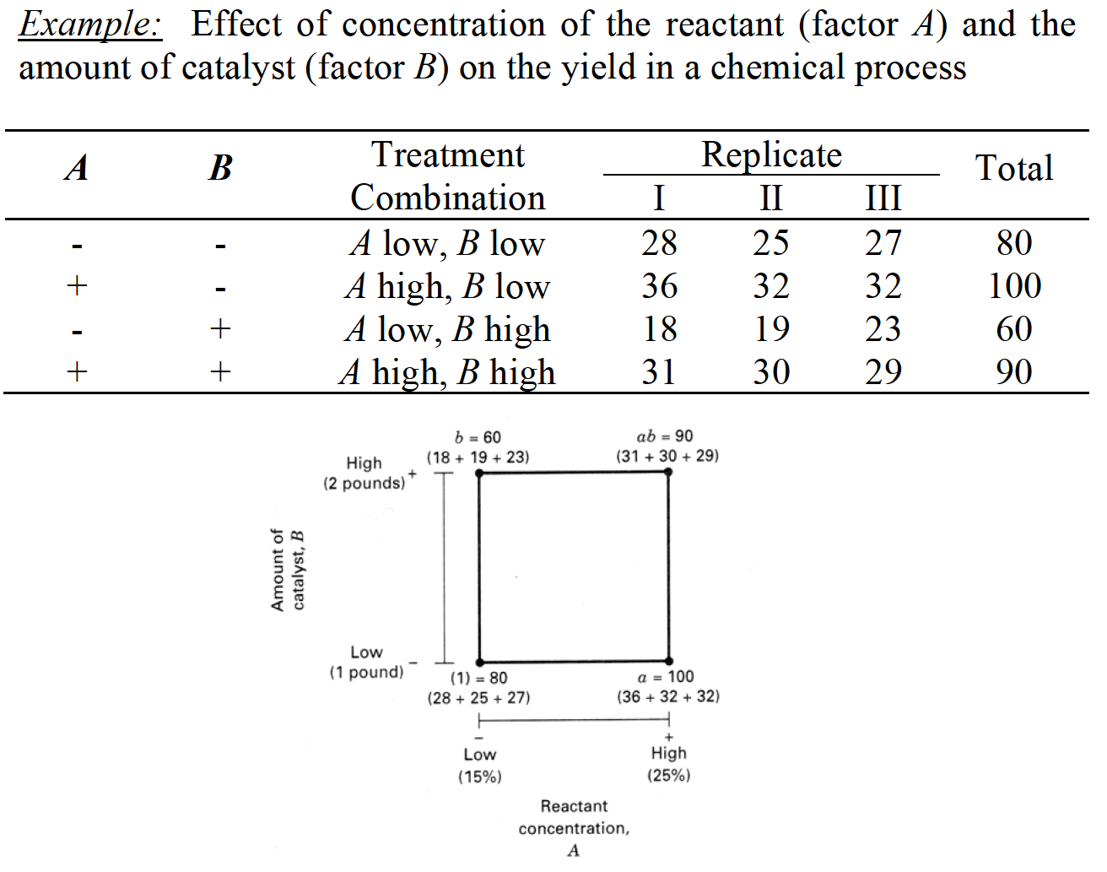
THE 2² DESIGN

Slide 4
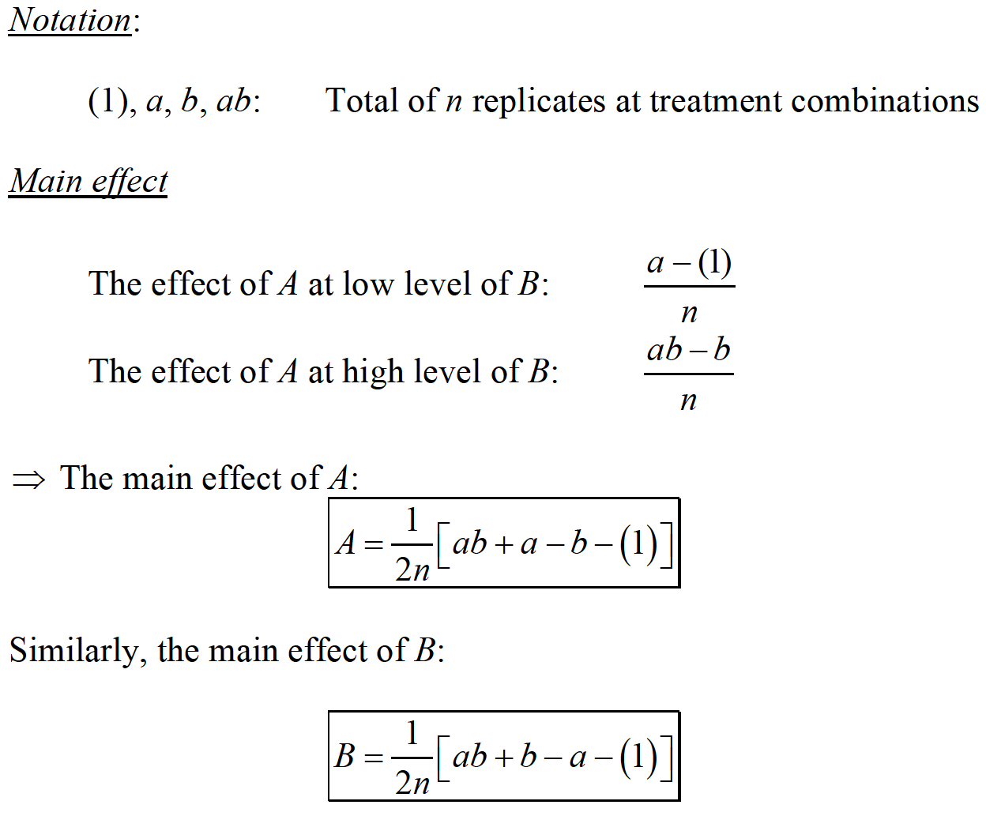
THE 2² DESIGN

Slide 5
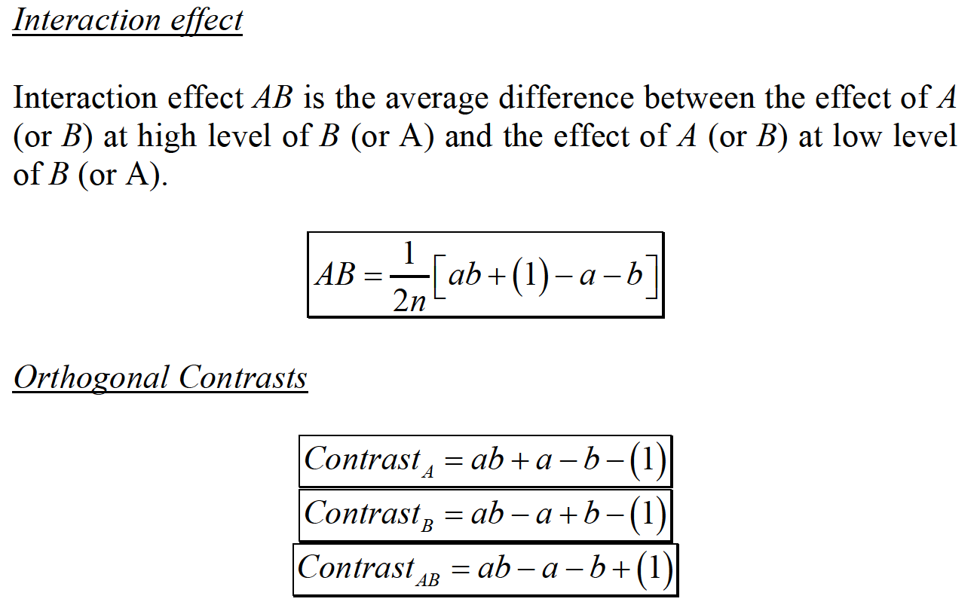
THE 2² DESIGN

Slide 6
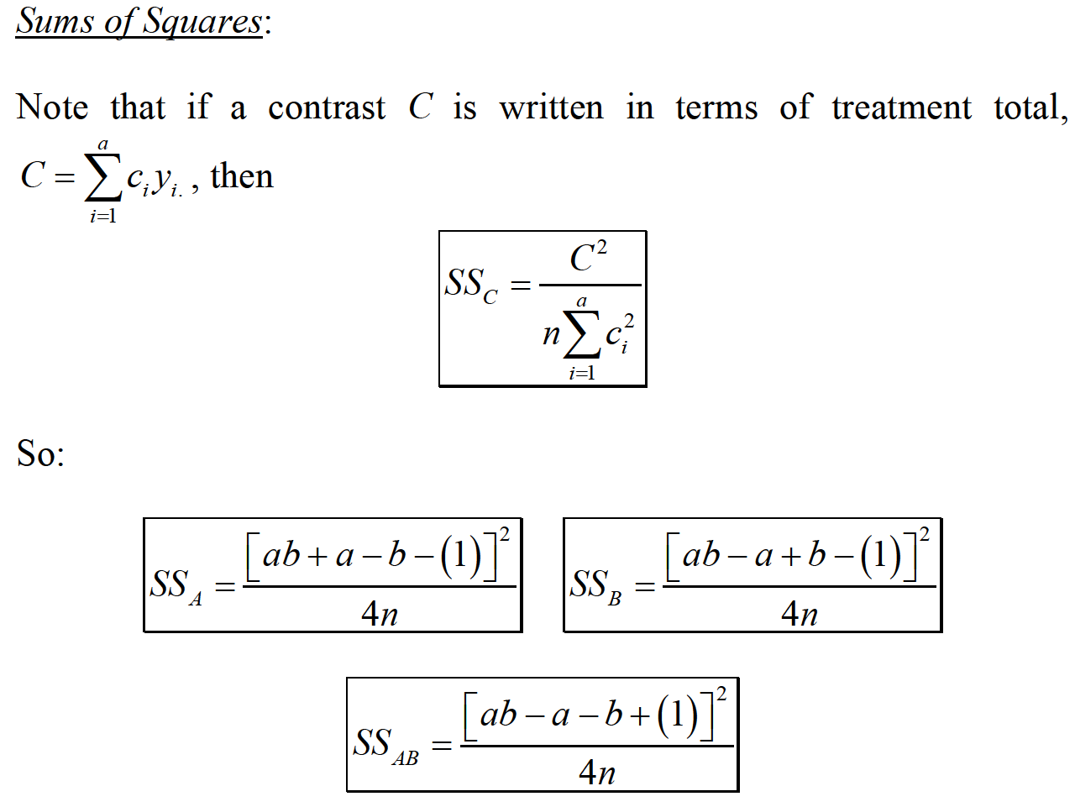
THE 2² DESIGN

Slide 7
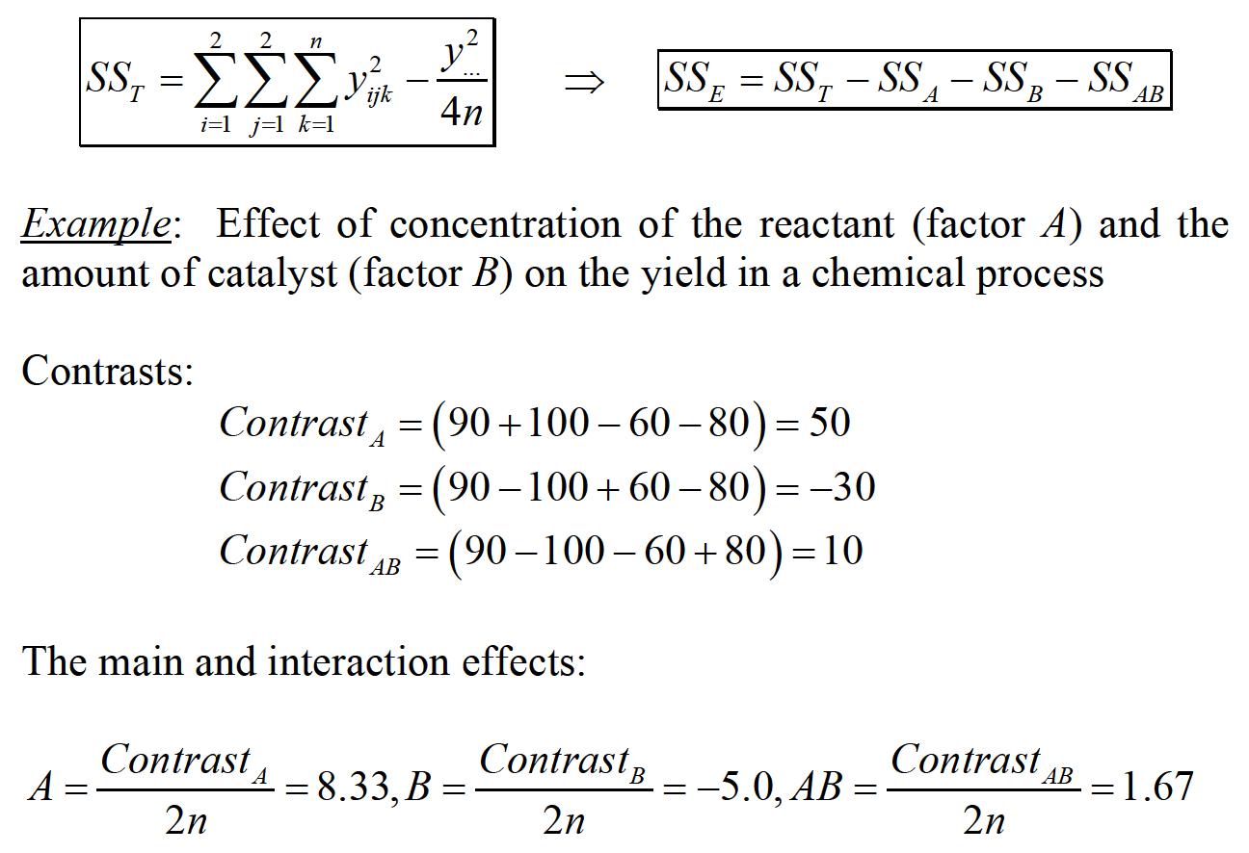
THE 2² DESIGN

Slide 8
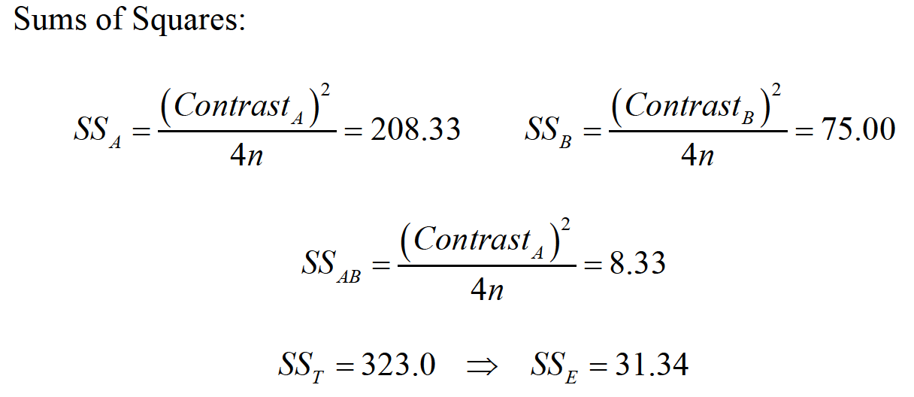
THE 2² DESIGN

Slide 9
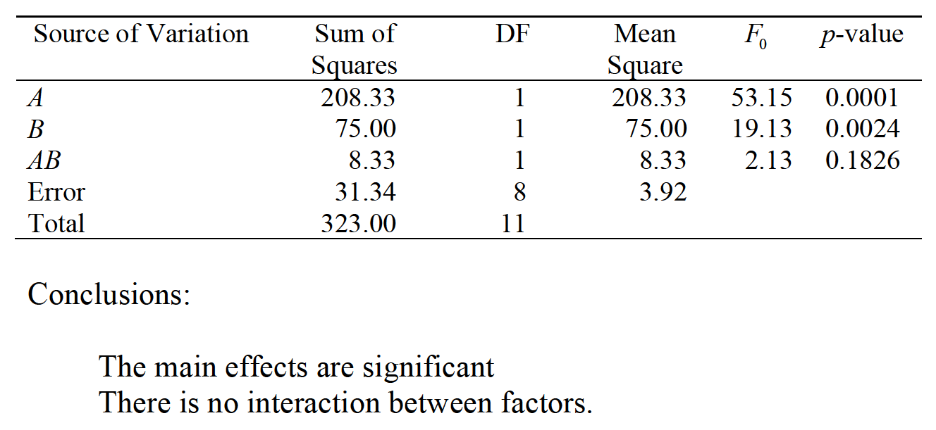
THE 2² DESIGN

Slide 10
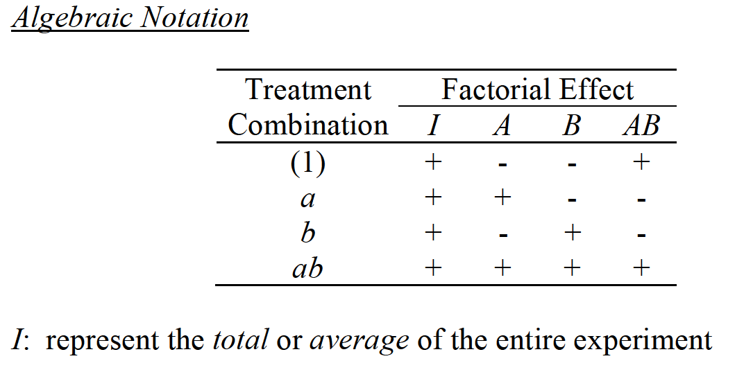
THE 2² DESIGN

Slide 11
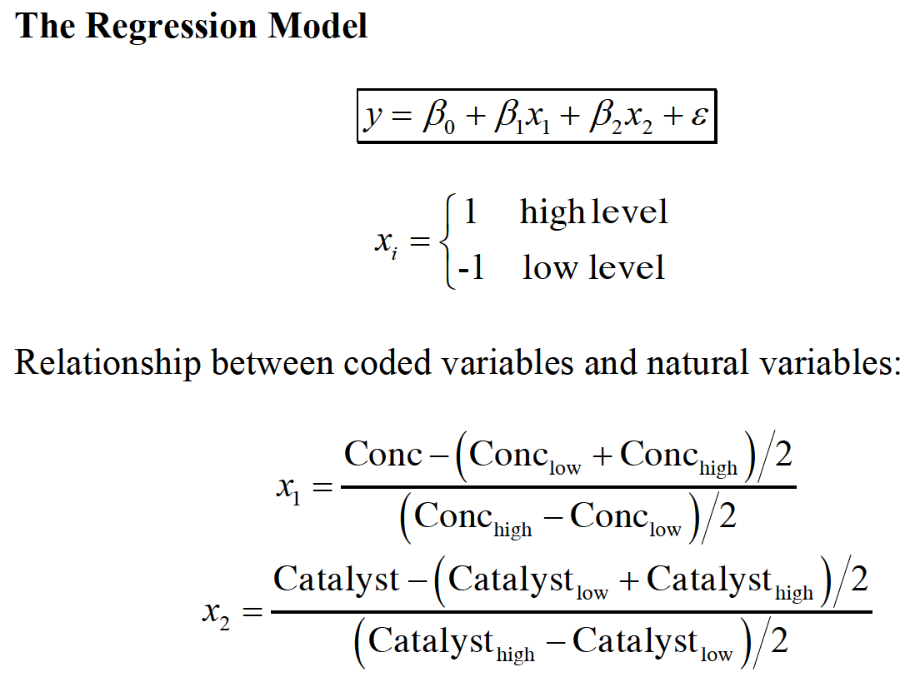
THE 2² DESIGN

Slide 12
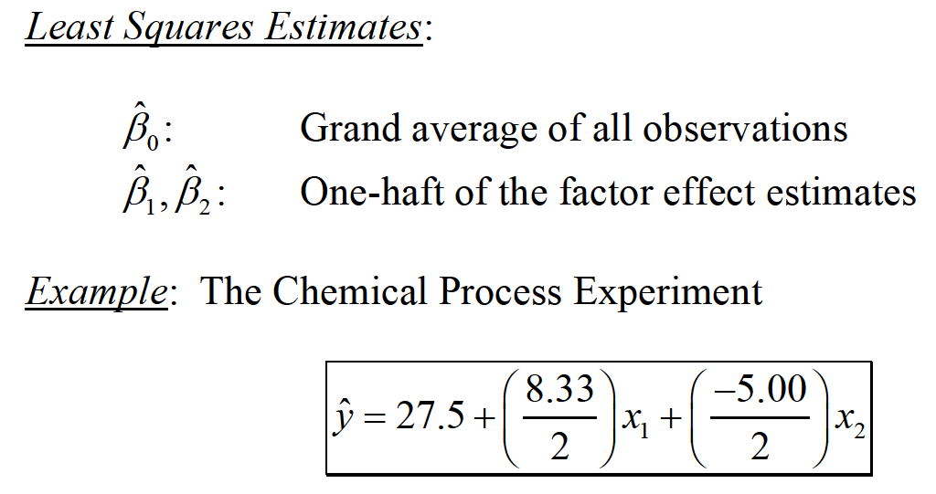
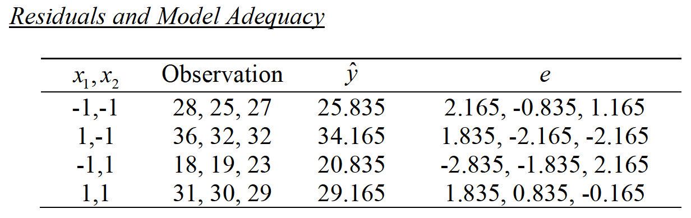
THE 2² DESIGN

Slide 13
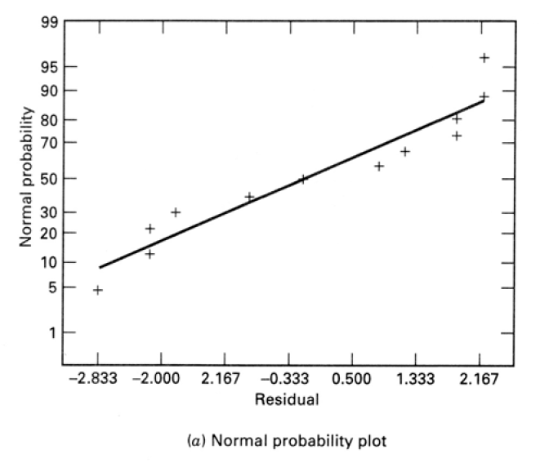
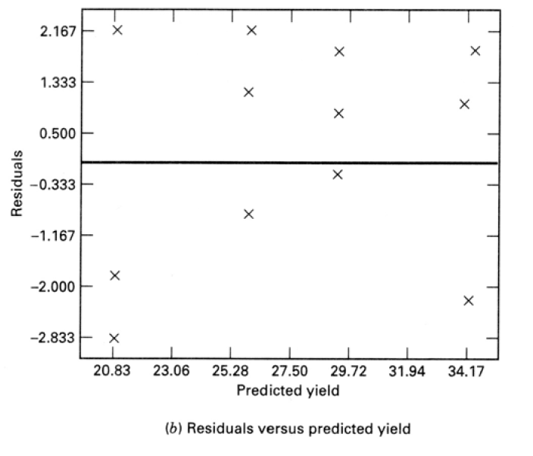

THE 2² DESIGN

Slide 14
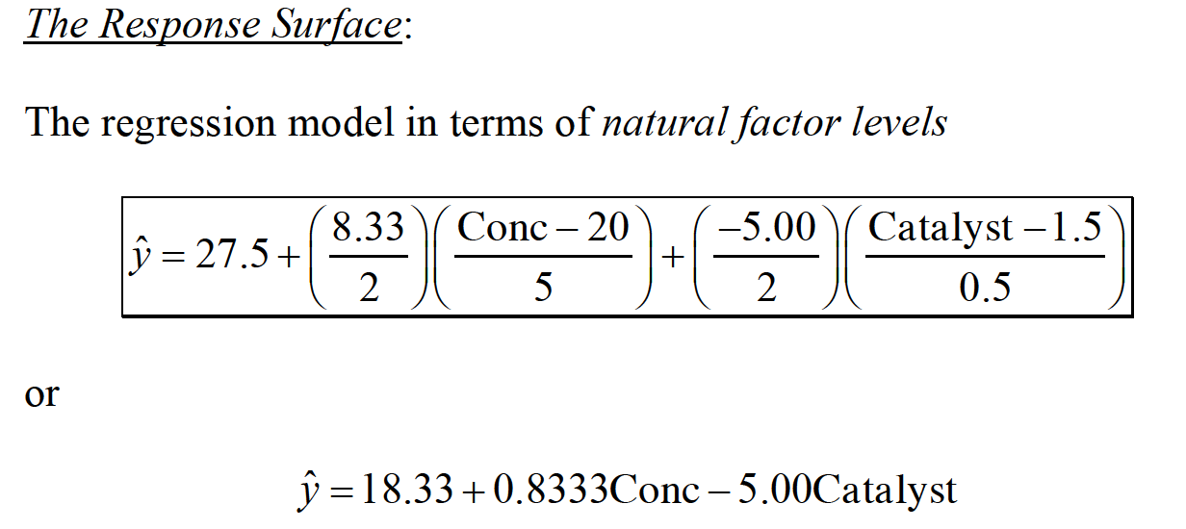
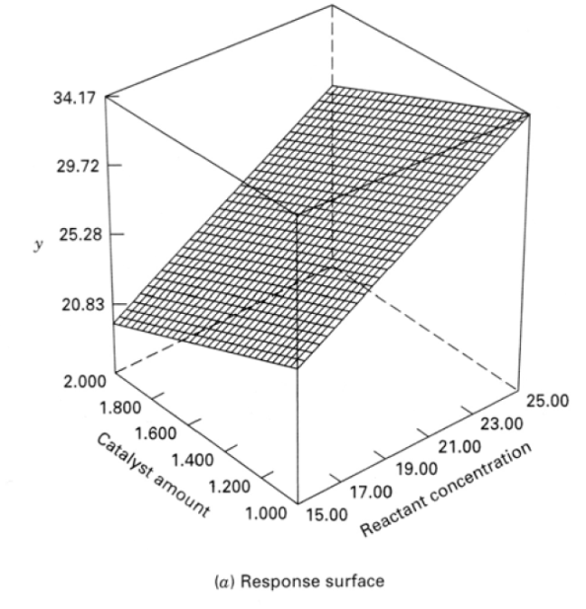
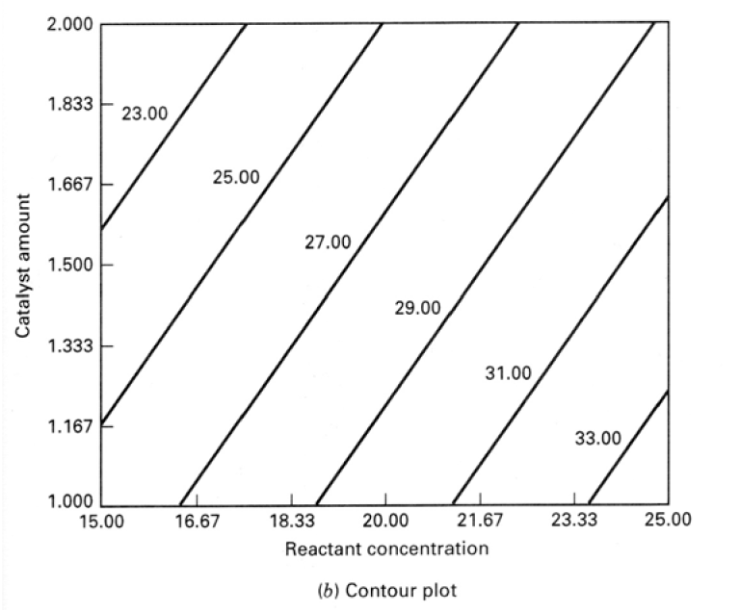
THE 2² DESIGN

Slide 15
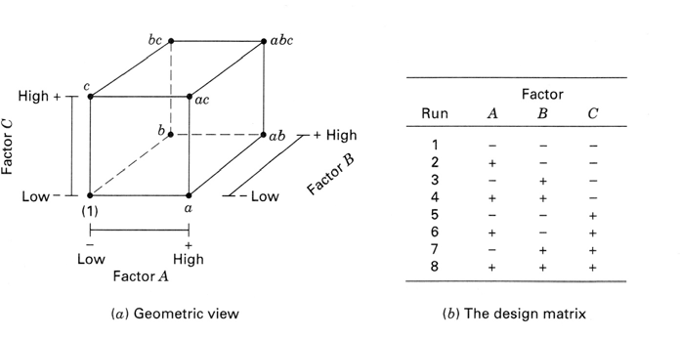
THE 2³ DESIGN

Slide 16
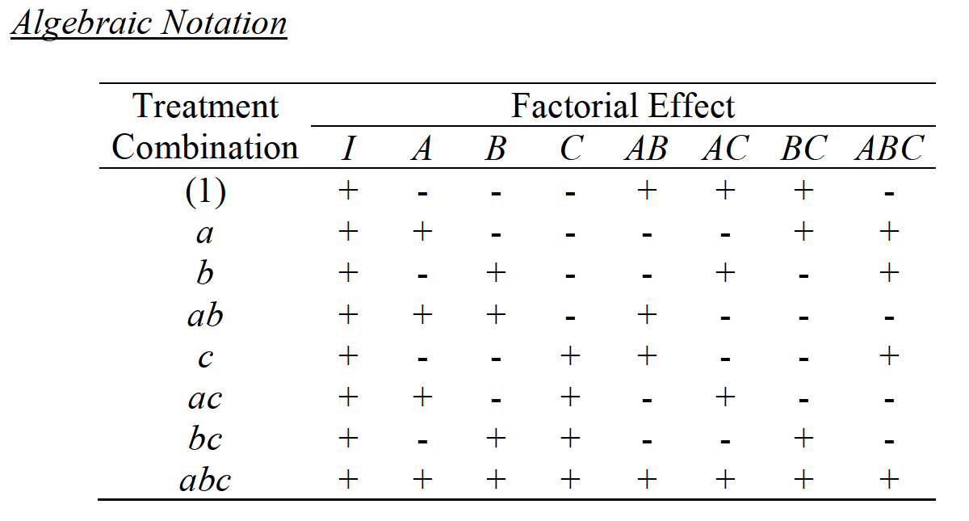
THE 2³ DESIGN

Slide 17
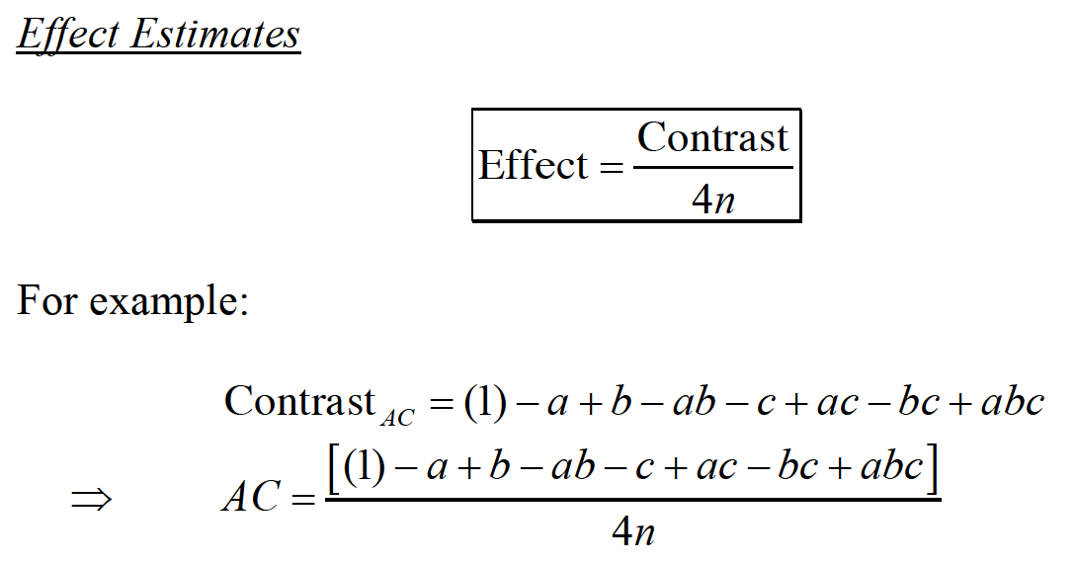
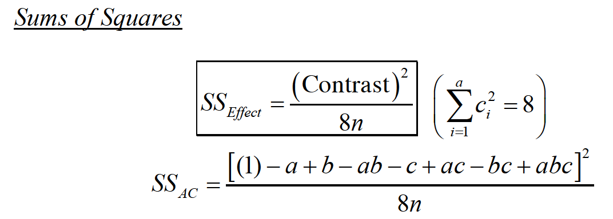
THE 2³ DESIGN

Slide 18
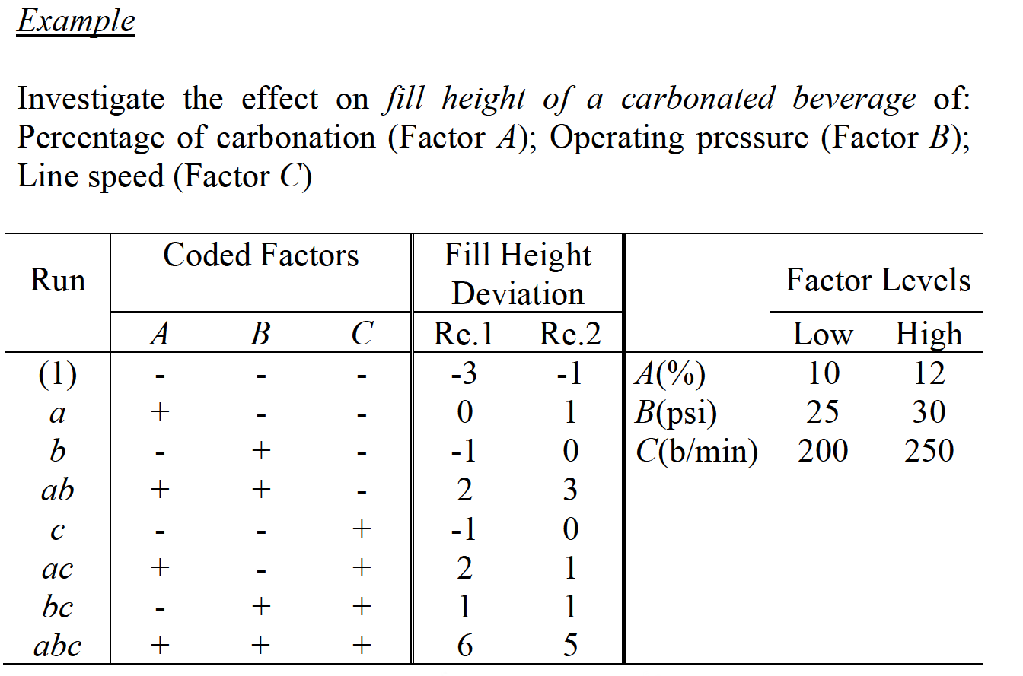
THE 2³ DESIGN

Slide 19
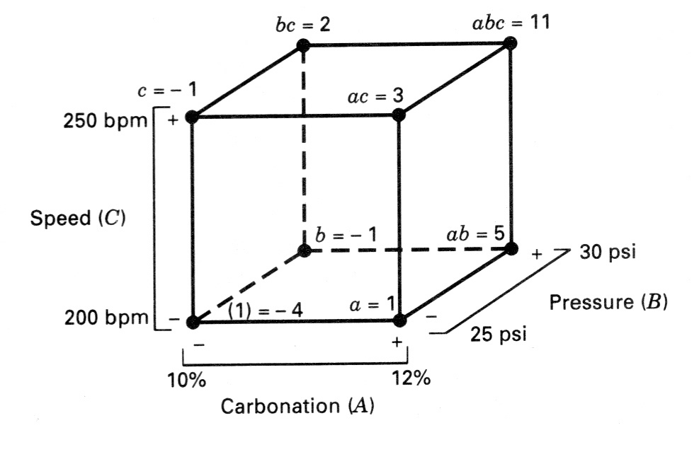
THE 2³ DESIGN

Slide 20
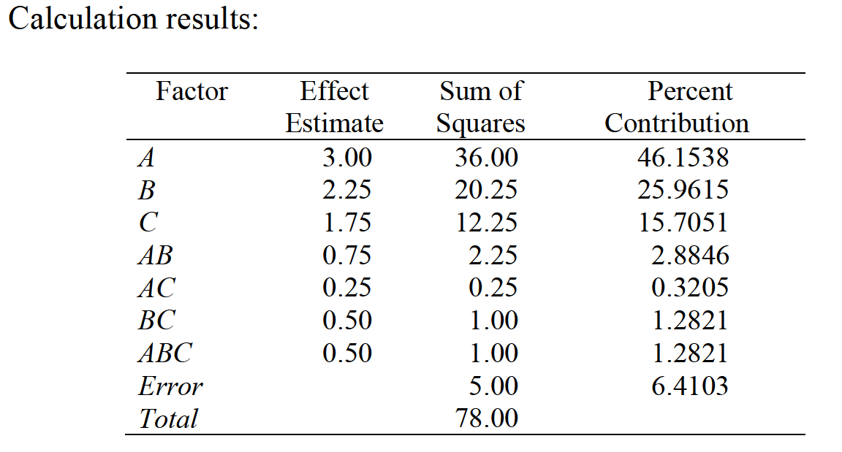
THE 2³ DESIGN

Slide 21
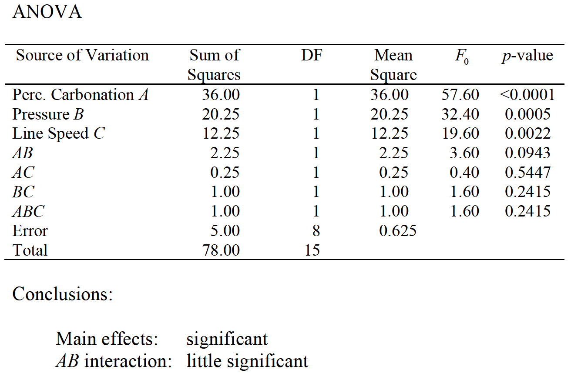
THE 2³ DESIGN

Slide 22
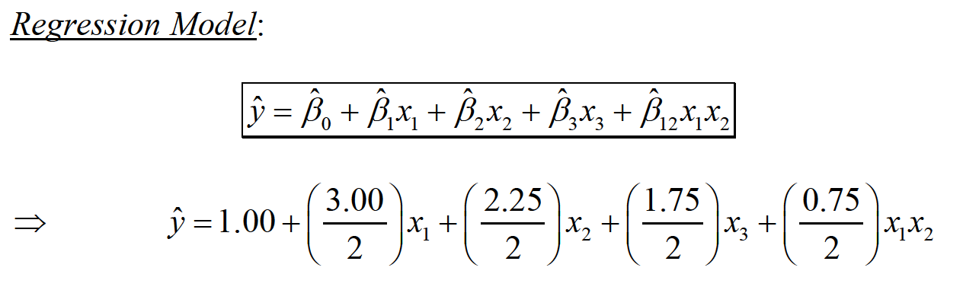
THE 2³ DESIGN

Slide 23
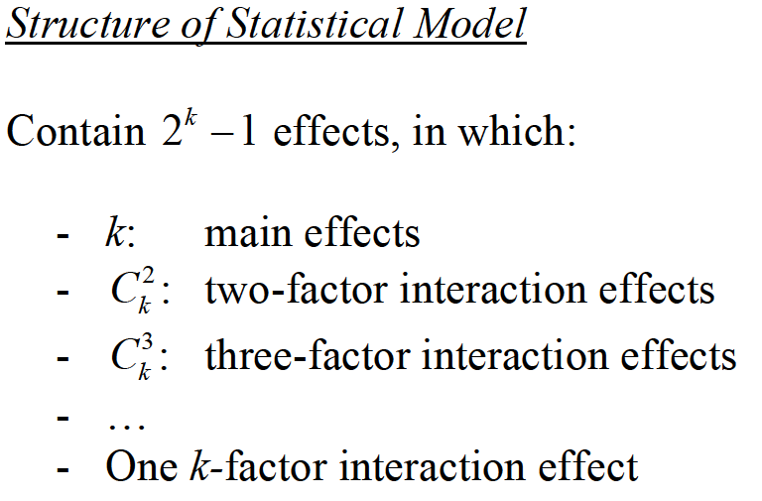
THE 2^{k} DESIGN

Slide 24
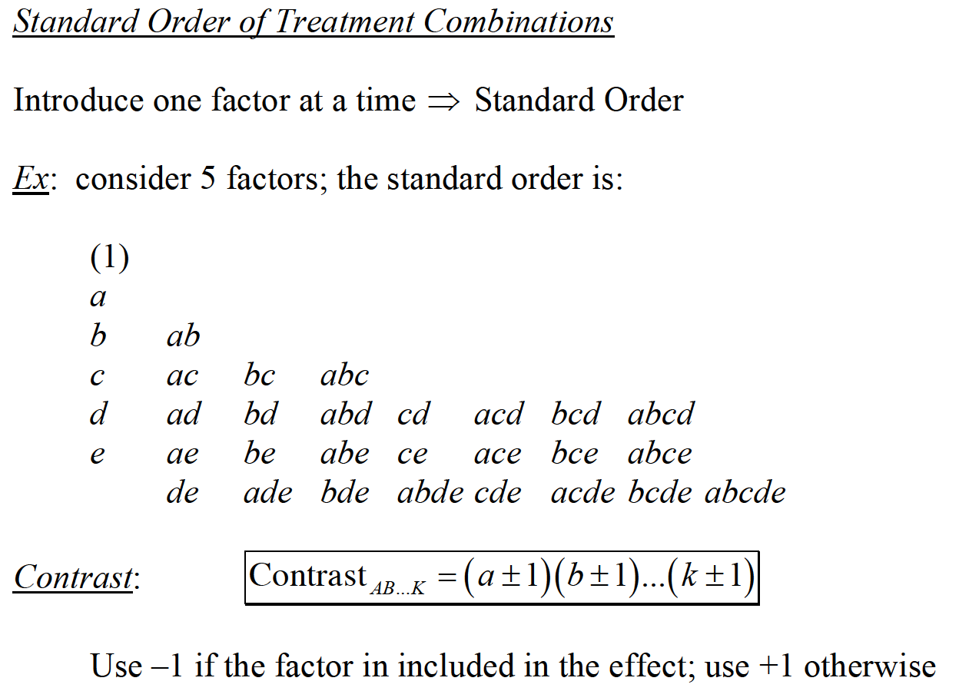
THE 2^{k} DESIGN

Slide 25
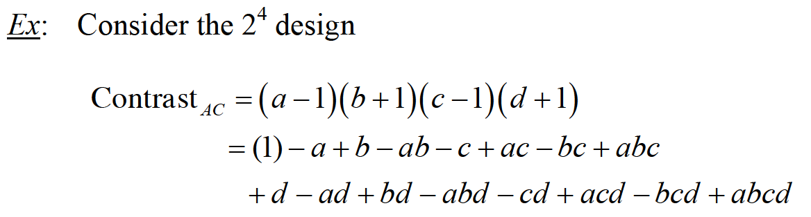
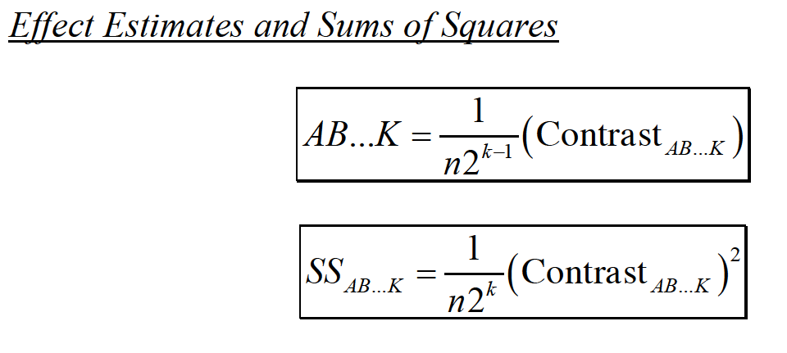
THE 2^{k} DESIGN

Slide 26
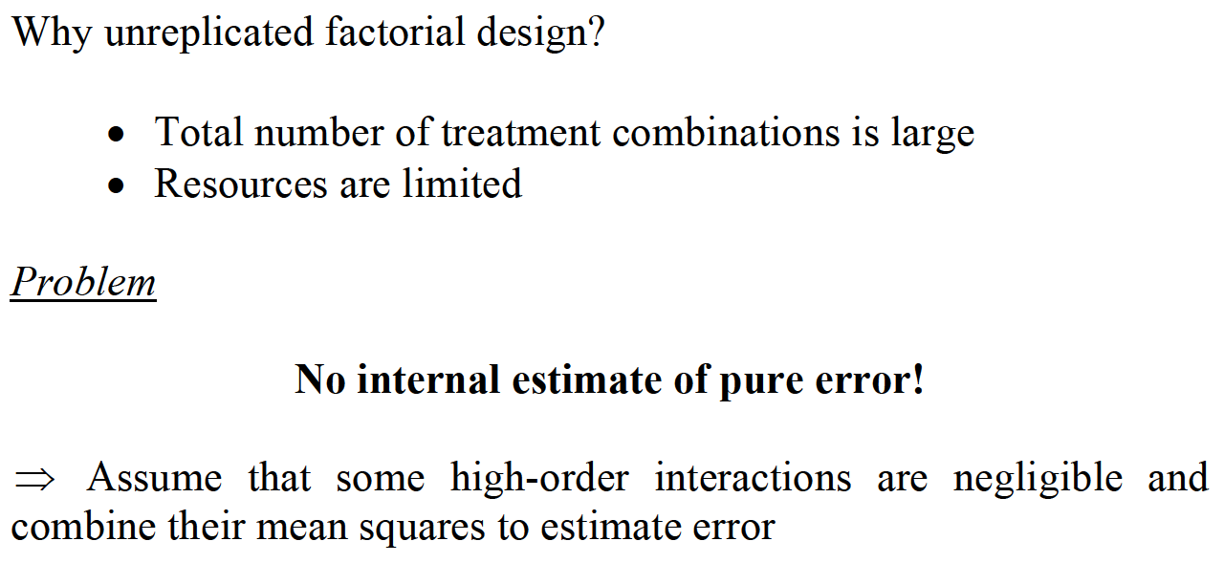
A SINGLE REPLICATE 2^{k} DESIGN

Slide 27
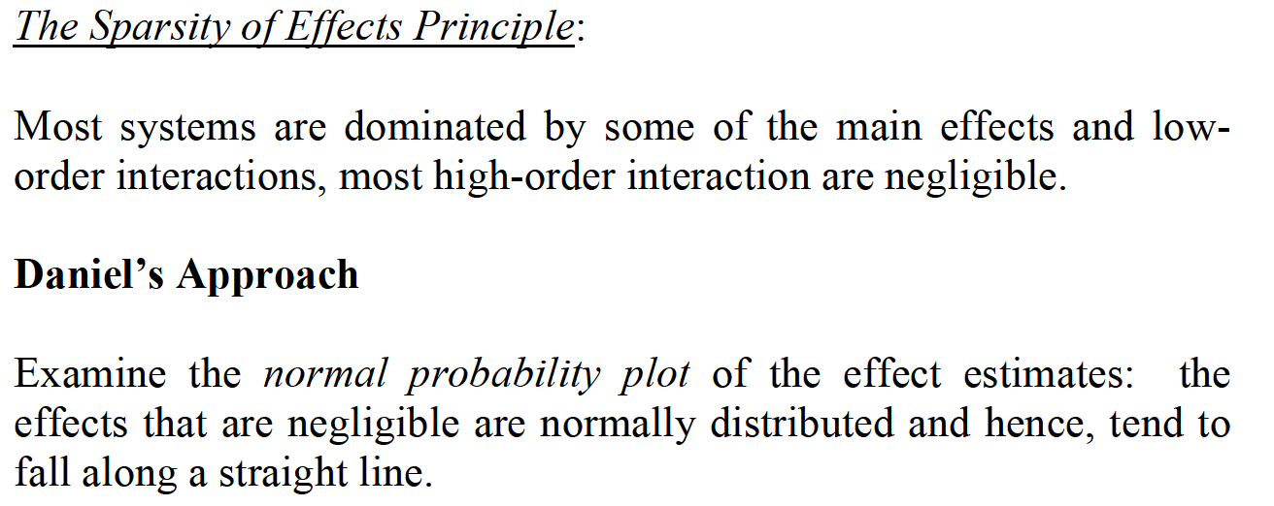
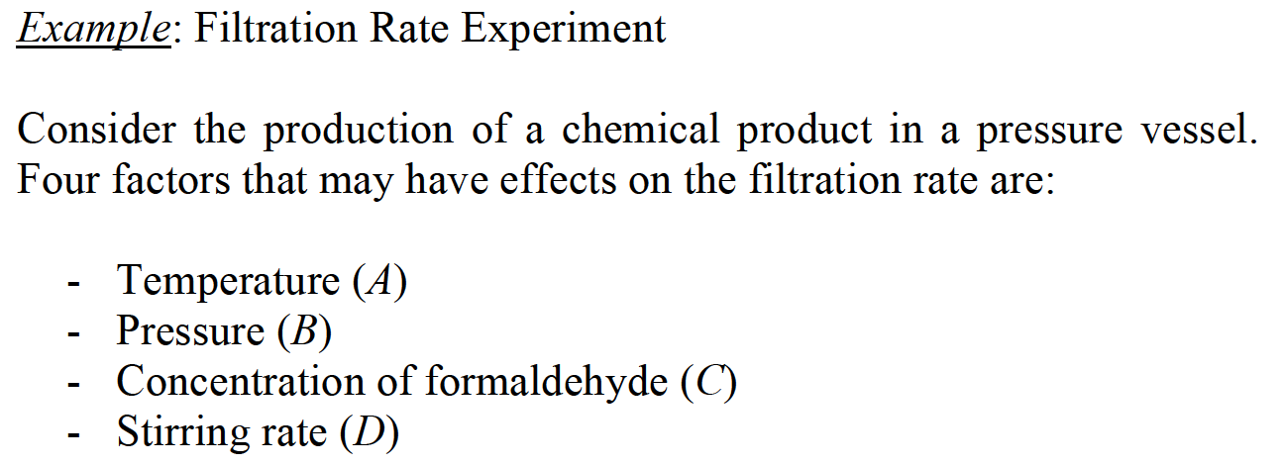
A SINGLE REPLICATE 2^{k} DESIGN

Slide 28
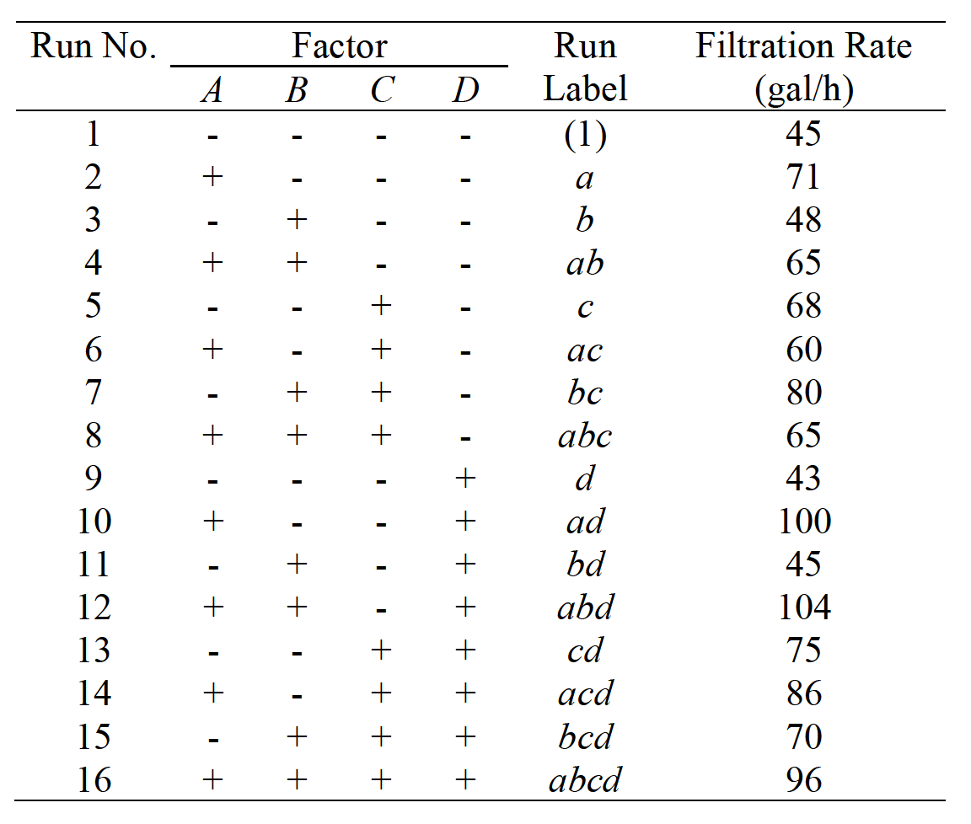
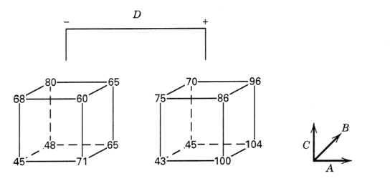
A SINGLE REPLICATE 2^{k} DESIGN

Slide 29
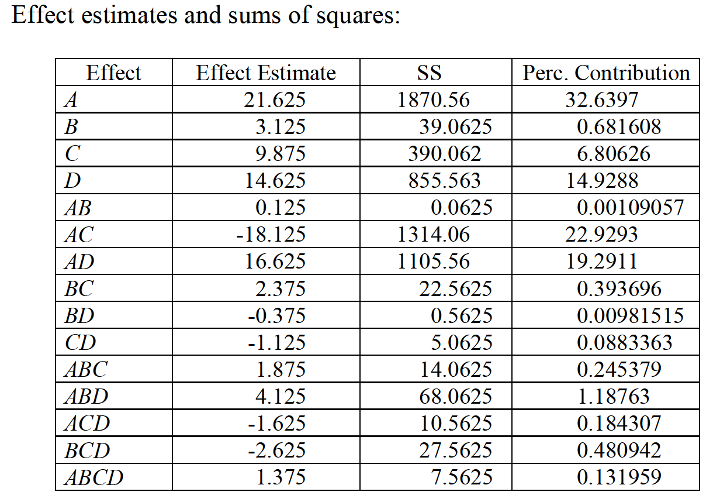
A SINGLE REPLICATE 2^{k} DESIGN

Slide 30
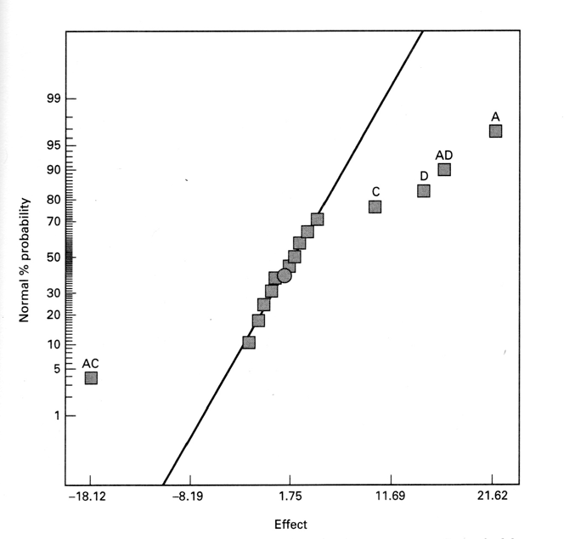
A SINGLE REPLICATE 2^{k} DESIGN

Slide 31
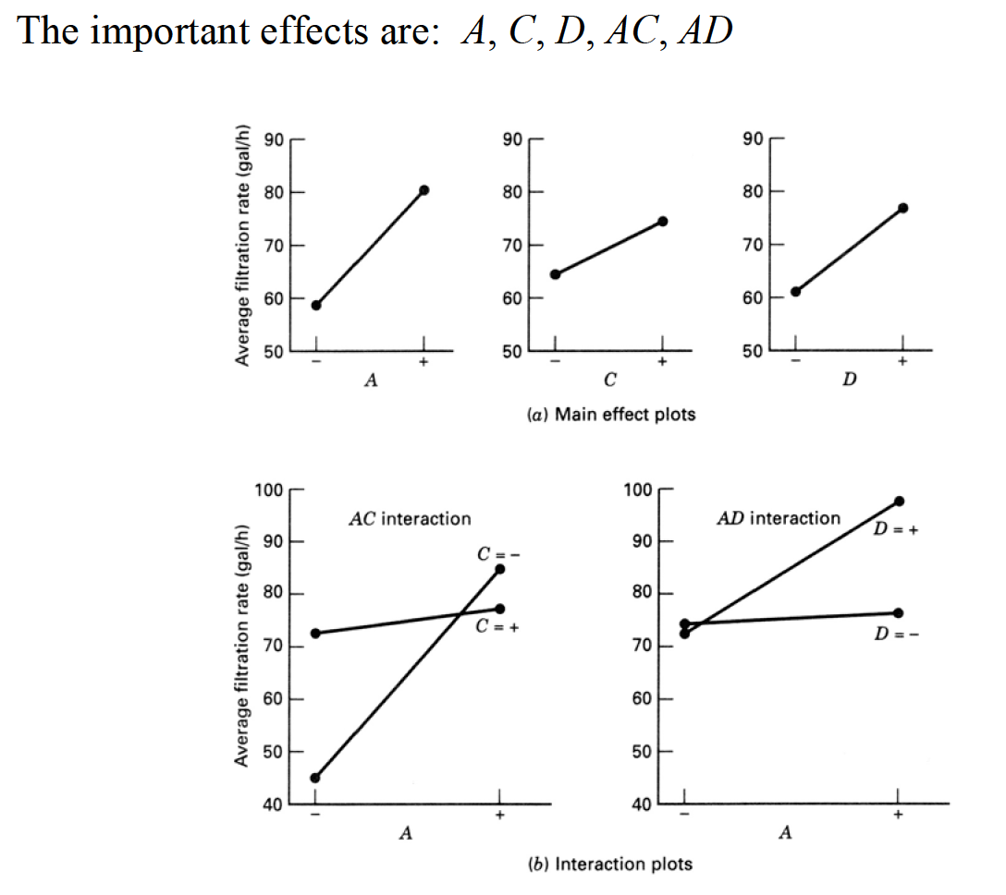
A SINGLE REPLICATE 2^{k} DESIGN

Slide 32
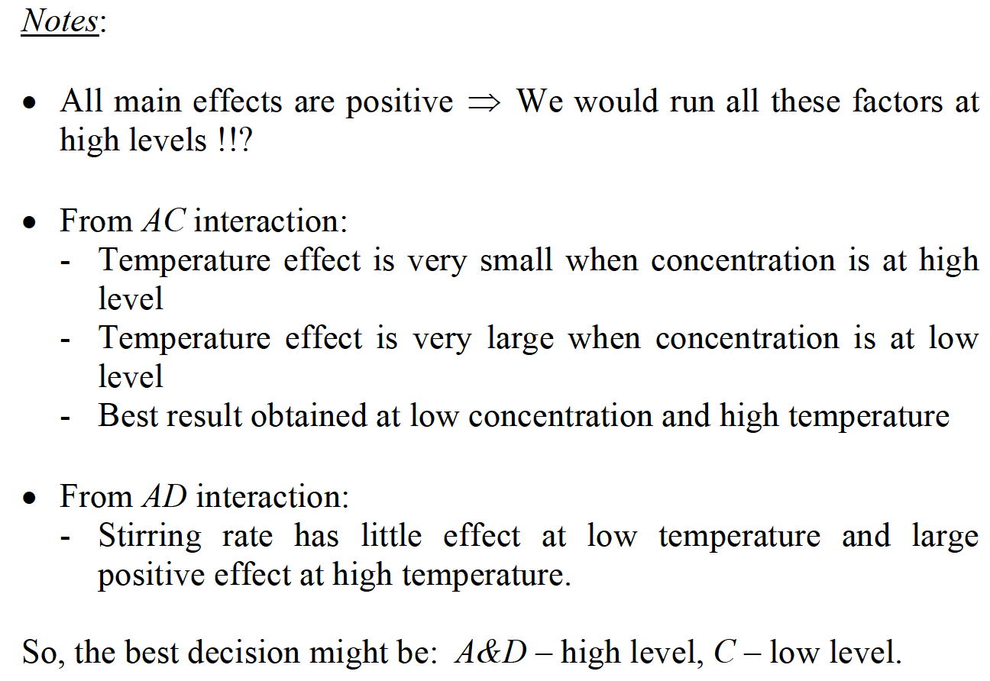
A SINGLE REPLICATE 2^{k} DESIGN

Slide 33
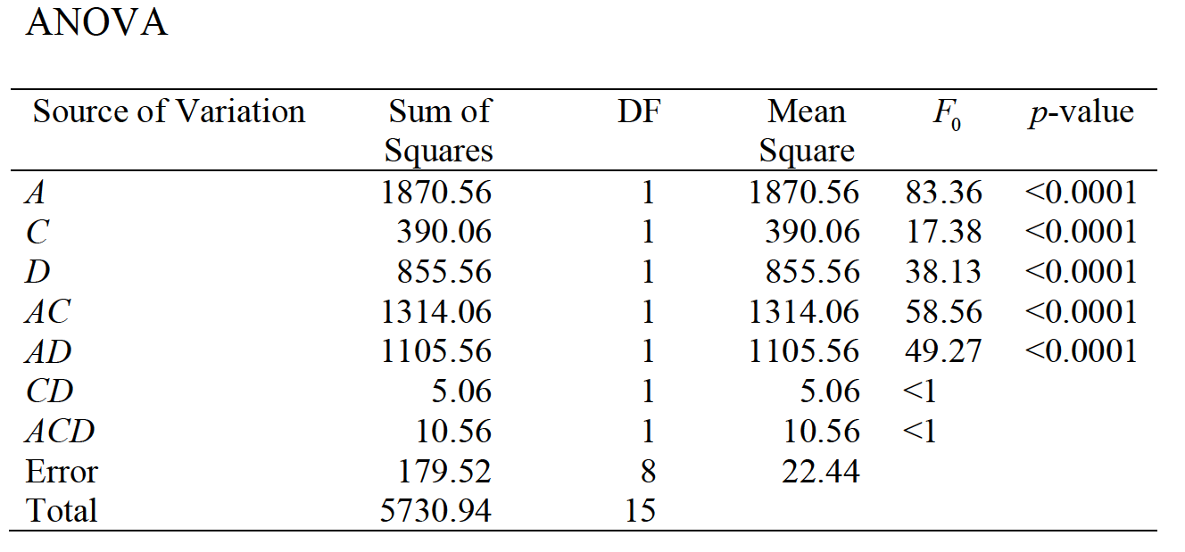
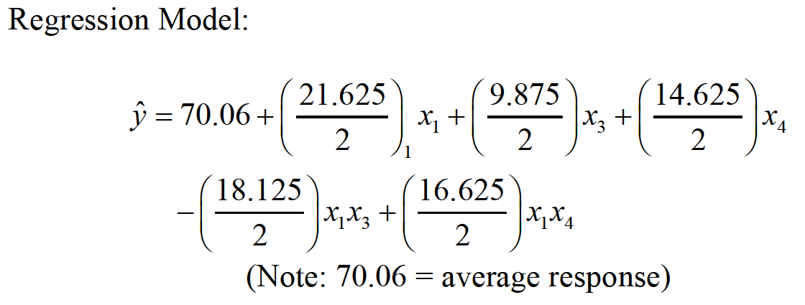
A SINGLE REPLICATE 2^{k} DESIGN

Slide 34
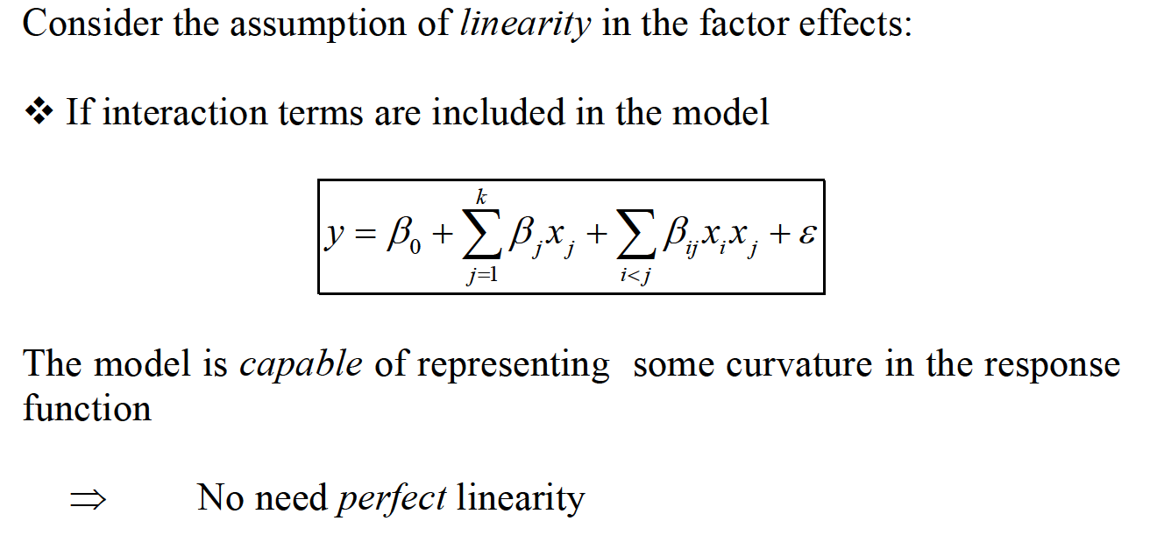
ADDITION OF CENTER POINT IN 2^{k} DESIGN

Slide 35
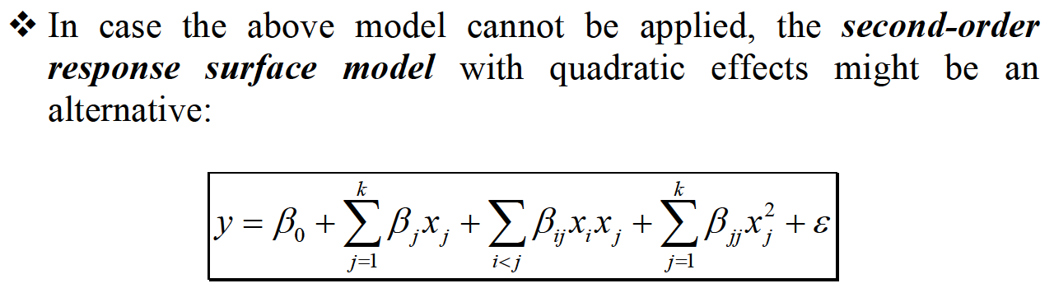
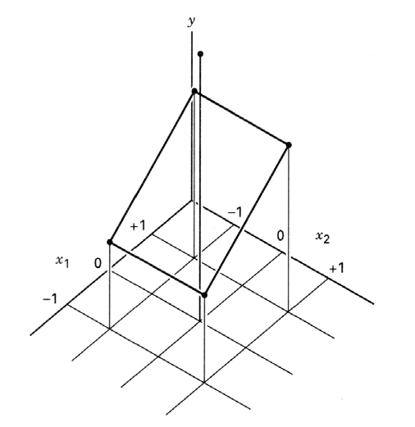
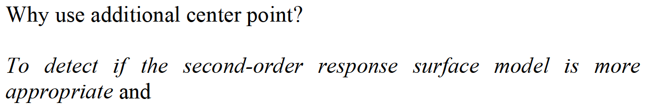
ADDITION OF CENTER POINT IN 2^{k} DESIGN

Slide 36
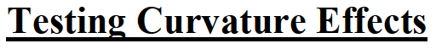
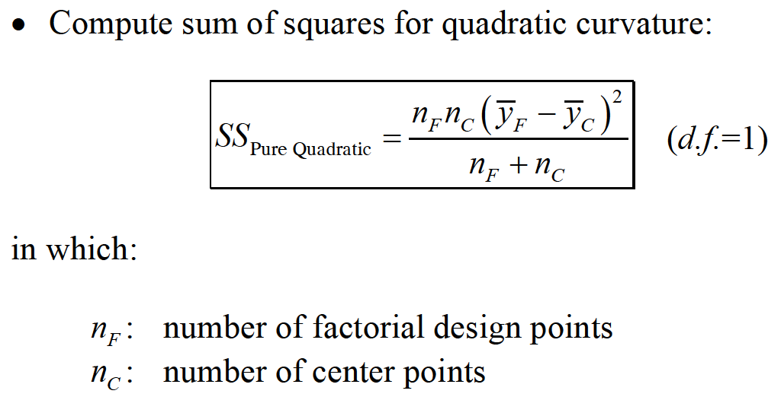
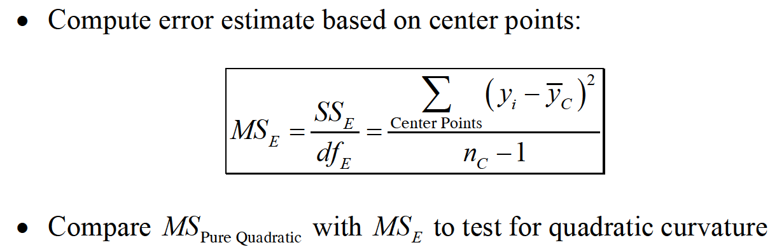
ADDITION OF CENTER POINT IN 2^{k} DESIGN

Slide 37
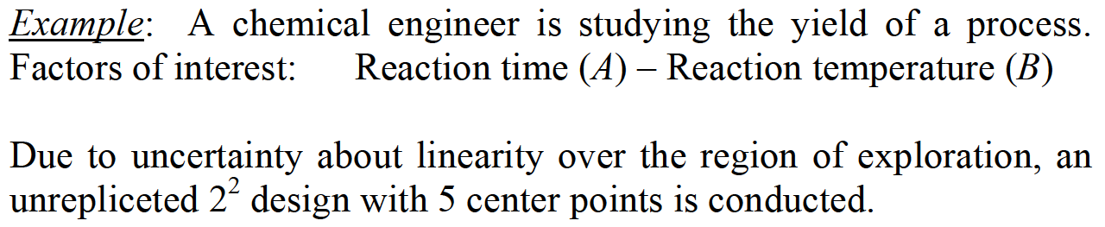
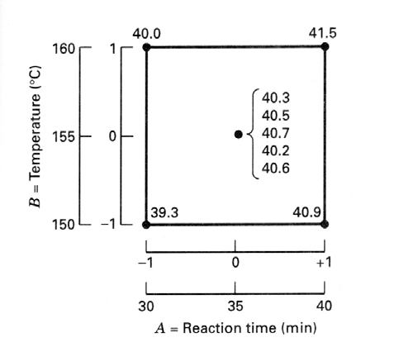

ADDITION OF CENTER POINT IN 2^{k} DESIGN

Slide 38

ADDITION OF CENTER POINT IN 2^{k} DESIGN

Slide 39

CONFOUNDING IN THE 2^{k} DESIGN

Slide 40

CONFOUNDING IN TWO BLOCKS

Slide 41

CONFOUNDING IN TWO BLOCKS

Slide 42

CONFOUNDING IN TWO BLOCKS

Slide 43


CONFOUNDING IN TWO BLOCKS

Slide 44

CONFOUNDING IN TWO BLOCKS

Slide 45

CONFOUNDING IN TWO BLOCKS

Slide 46



CONFOUNDING IN TWO BLOCKS

Slide 47


CONFOUNDING IN TWO BLOCKS

Slide 48

CONFOUNDING IN TWO BLOCKS

Slide 49


CONFOUNDING IN TWO BLOCKS

Slide 50


CONFOUNDING IN TWO BLOCKS

Slide 51

CONFOUNDING IN TWO BLOCKS

Slide 52


CONFOUNDING IN TWO BLOCKS

Slide 53


CONFOUNDING IN TWO BLOCKS

Slide 54

CONFOUNDING IN FOUR BLOCKS

Slide 55

CONFOUNDING IN FOUR BLOCKS

Slide 56

CONFOUNDING IN 2^{P} BLOCKS

Slide 57


PARTIAL CONFOUNDING

Slide 58

PARTIAL CONFOUNDING

Slide 59


PARTIAL CONFOUNDING

Slide 60

PARTIAL CONFOUNDING

Slide 61

PARTIAL CONFOUNDING

Slide 62

PARTIAL CONFOUNDING

Slide 63

PARTIAL CONFOUNDING

Slide 64

PARTIAL CONFOUNDING

Slide 65

PARTIAL CONFOUNDING

